Slide 1

PIVOT TABLES FOR DATA SUMMURIZATION

Slide 2

Introduction
A Pivot Table is a powerful data analysis tool in Excel that allows you to summarize, analyze, and visualize large datasets in a structured and dynamic way.
Pivot Tables provide a flexible and interactive approach in organizing and interpreting data, making complex datasets more manageable.
It makes it easier for users to derive insights and present information in a clear and meaningful manner.

Slide 3

KEY COMPONENTS
Rows and columns
You can organize your data by dragging and dropping fields into rows and columns areas of the pivot table.
Values
The values area allows to perform calculations on your data,such as sum,count,average etc.
Filters
Filters help you narrow down the data displayed in the pivot table based on specific criteria.

Slide 4
Steps to create a Pivot Table
1) Select Your Data: Highlight the data range you want to include in the Pivot Table.
2) Insert a Pivot Table: Go to the "Insert" tab and select "Pivot Table.“
3) Choose Your Data Range: Confirm that the selected range is correct.
4) Design Your Pivot Table: Drag and drop fields into the Rows, Columns, Values, and Filters areas.
5) Customize Layout and Style: Format the Pivot Table as needed, adjusting styles, and layouts.
6) Perform Calculations: Add calculated fields or items to perform specific calculations.
7) Refresh Data: If your source data changes, you can refresh the Pivot Table to reflect the modifications

Slide 5

Steps to create visuals
Craft your visualization: Once you have arranged your fields in the PivotTable Fields pane, it's time to create the visual:
Click anywhere within the PivotTable.
Go to the ‘Insert’ tab and select the desired chart type (e g, Bar Chart, Pie Chart,Line chart).Choose the chart that best conveys the relationships within your data.

Slide 6
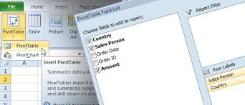
2. Customize your visual:
Excel offers various formatting options to enhance your chart. Youcan:
Change chart type after creation.
Modify colors, fonts, and chart styles.
Add data labels and titles for clarity.
3.Fine-tune the PivotTable (optional):
You can further refine your analysis by:
Right-clicking on a specific data point in the PivotTable.
Selecting "Show Values" or "Show Values As % of Column Total" to gain deeper insights.

Slide 7
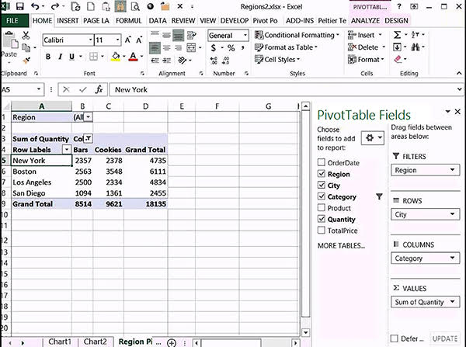
Example of a Pivot Table

Slide 8

Conclusion
In conclusion, Excel's PivotTables are an essential tool for anyone working with data. They provide a flexible and efficient way to analyze and present large sets of data, making it easy to identify trends and patterns that might otherwise go unnoticed.

Slide 9

Thank you.
If you have any questions?
thahliyamist@gmail.com

